Slide 1

C# Advanced
Course Introduction
SoftUni Team
Technical Trainers
Software University
https://softuni.bg

Slide 2
Table of Contents
Course Objectives
Training and Team
Course Organization
Course Infrastructure
Evaluation Criteria

Slide 3
Have a Question?
sli.do
#csharp-advanced

Slide 4














SoftUni Diamond Partners

Slide 5

Educational Partners

Slide 6

Course Objectives

Slide 7
C# Advanced Module Goals
Working with linear data structures
Getting familiar with streams and files
Creating custom data structures
Building class hierarchies
Working with exceptions
Applying principles and good practices for building quality software
Testing application correctness
7

Slide 8
C# Advanced Course Goals
Working with linear data structures
Stacks, queues and multidimensional arrays
Getting familiar with streams and files
Creating custom data structures
List<T>, Stack<T> and LinkedList<T>
Simple algorithms
Recursion, Sorting and Searching
8

Slide 9
Practical Programming Exam
3 practical problems for 4 hours
The first two problems may include:
Stacks and Queues
Multidimensional Arrays
Dictionaries
Defining Classes
Automated judge system
http://judge.softuni.bg
Solutions are evaluated for correctness only
Code quality is still not measured
9

Slide 10
Theoretical Exam
You will have 30 minutes once you start
Multiple choice with one correct answer
English
Automated quiz system
Available during the practical exam and 30 minutes after it
You can submit your answers just one time
Advice: Start it when you finish the practical exam
10

Slide 11

The Team
Your Trainers and Mentors

Slide 12
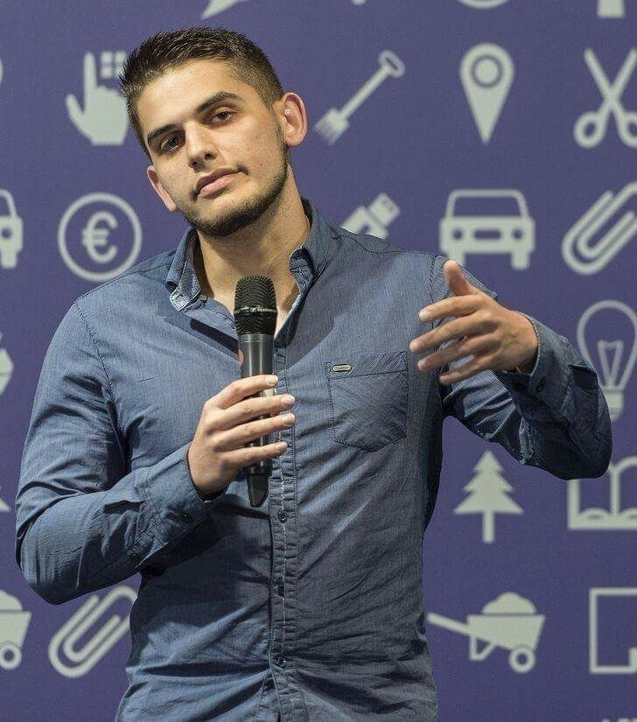
Viktor Dakov
Manager, Software Engineering @ Nuvolo
Worked at Amazon
John Atanasoff award
Participated in many programming contests
9+ Years of Experience as a Developer

Slide 13
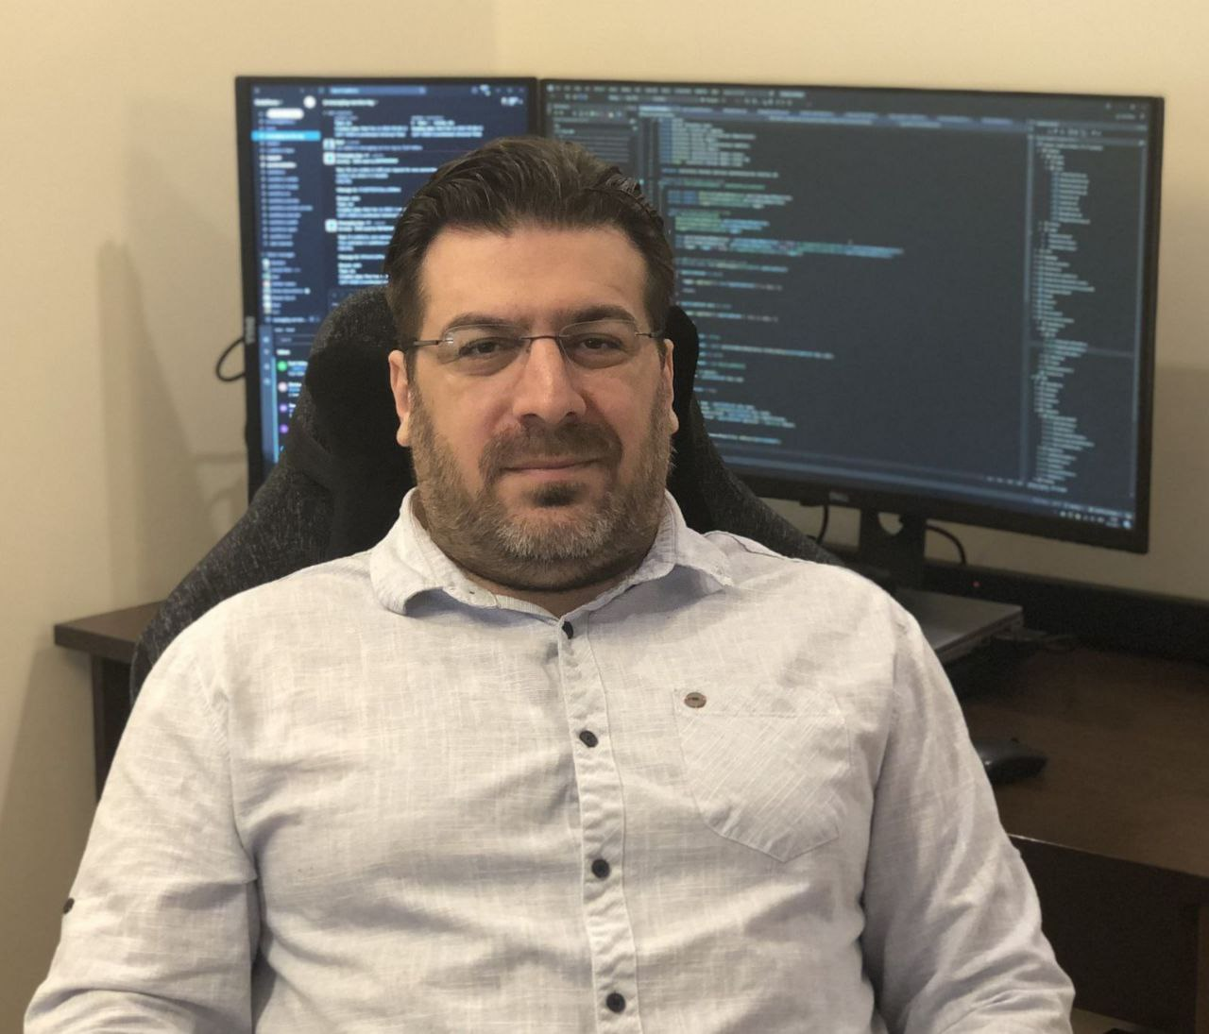
Georgi Inkov
C# Web Developer
8 years experience in .NET ecosystem
Graduated the first class @ SoftUni
Worked in Cashwave, Vivacom & Fourth
Now works as a back-end developer
@ Excitel Technology

Slide 14

Course Organization

Slide 15
C# Advanced Course – Timeline
10-Jan-2023
18-Feb-2023
12-Apr-2023
C# Advanced
6 weeks * 4 times / week
12 credits
Start: 10-Jan-2023
Theoretical Exam: 18-February-2023
Practical Exam: 18-February-2023
Theoretical Exam Retake: 12-April-2023
Practical Exam Retake: 12-April-2023

Slide 16

Homework Assignments & Exercises
Your homework is mainly work in class
Lesson days → slides + live demos + exercises
Exercise days → only exercises
How to submit your homework?
Submitted in the judge system
Do your homework when it's due
Assignments pile up quickly

Slide 17


SoftUni Certificate
Practical Exam 100%
Homework 5% (bonus)
Evaluation
17

Slide 18
CPE Certificate
Practical Exam
Theoretical Exam
Evaluation
18

Slide 19



Course Web Site, Forum and FB Group
Official web site:
Official discussion forum:
Official Facebook group:
Community Facebook group:
https://softuni.bg/trainings/3957/csharp-advanced-january-2023
https://softuni.bg/forum/categories/30/
https://www.facebook.com/groups/CsharpAdvancedJanuary2023
https://www.facebook.com/groups/SoftUniCSharpCommunity/

Slide 20


Learn to Search in Internet
The course assignments require to search in Internet​
This is an important part of the learning process​
Some exercises intentionally have no hints​
Learn to find solutions!​
Software development includes ​ everyday searching and learning​
No excuses, just learn to study!​
Developers learn new technologies, tools, languages every day!​

Slide 21


The Free C# Fundamentals Textbook
The official textbook for the course
"Fundamentals of Computer Programming with C#", by Svetlin Nakov & Co., 2018, ISBN 9786190007784
English and Bulgarian versions (as PDF, ePub, …)
Freely downloadable from: www.introprogramming.info
The C# Programming courses @ SoftUni.bg partially follow the book

Slide 22
Questions?
Notes:
22

Slide 23
Trainings @ Software University (SoftUni)
Software University – High-Quality Education, Profession and Job for Software Developers
softuni.bg, about.softuni.bg
Software University Foundation
softuni.foundation
Software University @ Facebook
facebook.com/SoftwareUniversity
Software University Forums
forum.softuni.bg
23
Notes:
23

Slide 24

License
This course (slides, examples, demos, exercises, homework, documents, videos and other assets) is copyrighted content
Unauthorized copy, reproduction or use is illegal
© SoftUni – https://about.softuni.bg/
© Software University – https://softuni.bg
Notes:
24

